Slide 1
Doodle Jump
Stejara Dinulescu

Slide 2
Concept/Motivation
In a GAN that works with images, what is the relationship between input and output?
How do different inputs change the outputs?
More specifically, does the way in which the input was created affect the output (i.e. general trends, what is more visually interesting, etc.)?
How can I push the output so that it can stand alone as Art
Context/controversy about ownership + GANs
Can digital images produced by a machine be art?

Slide 3
Initial motivating questions/issues
What GAN can I use that best allows me to explore my above questions?
How do I work with this GAN?
Pre-trained? Train my own? Make my own algorithm?
Chose pre-trained GAN, SPADE-COCO, in RunwayML
Takes abstract images and converts it to real-life objects
RunwayML allows for easy working with GANs
What should I give as input to get interesting output?

Slide 4
Process: Exploring Input -> Output and HCI
Relations between inputs and outputs are explorations of different pathways of human-computer interaction
Physical drawings (human -> computer)
Digital drawings
Using Notes application on my iPhone (human/computer -> computer)
Using Drawing Manager (human -> computer -> human /computer -> computer)
Drawing Manager Library made by Jennifer Jacobs
Extensions of Drawing Manager Library made by Stejara
Plotter drawings
Digital drawings (human/computer -> machine -> computer)
Digital code in Processing (human -> computer -> computer)
Digital code in Processing (human -> computer -> computer)
Later question: how does pre-processing of an image affect an output (addition of another “computer” pathway)?

Slide 5
Hand-drawn inputs

Slide 6
Digitally drawn inputs

Slide 7
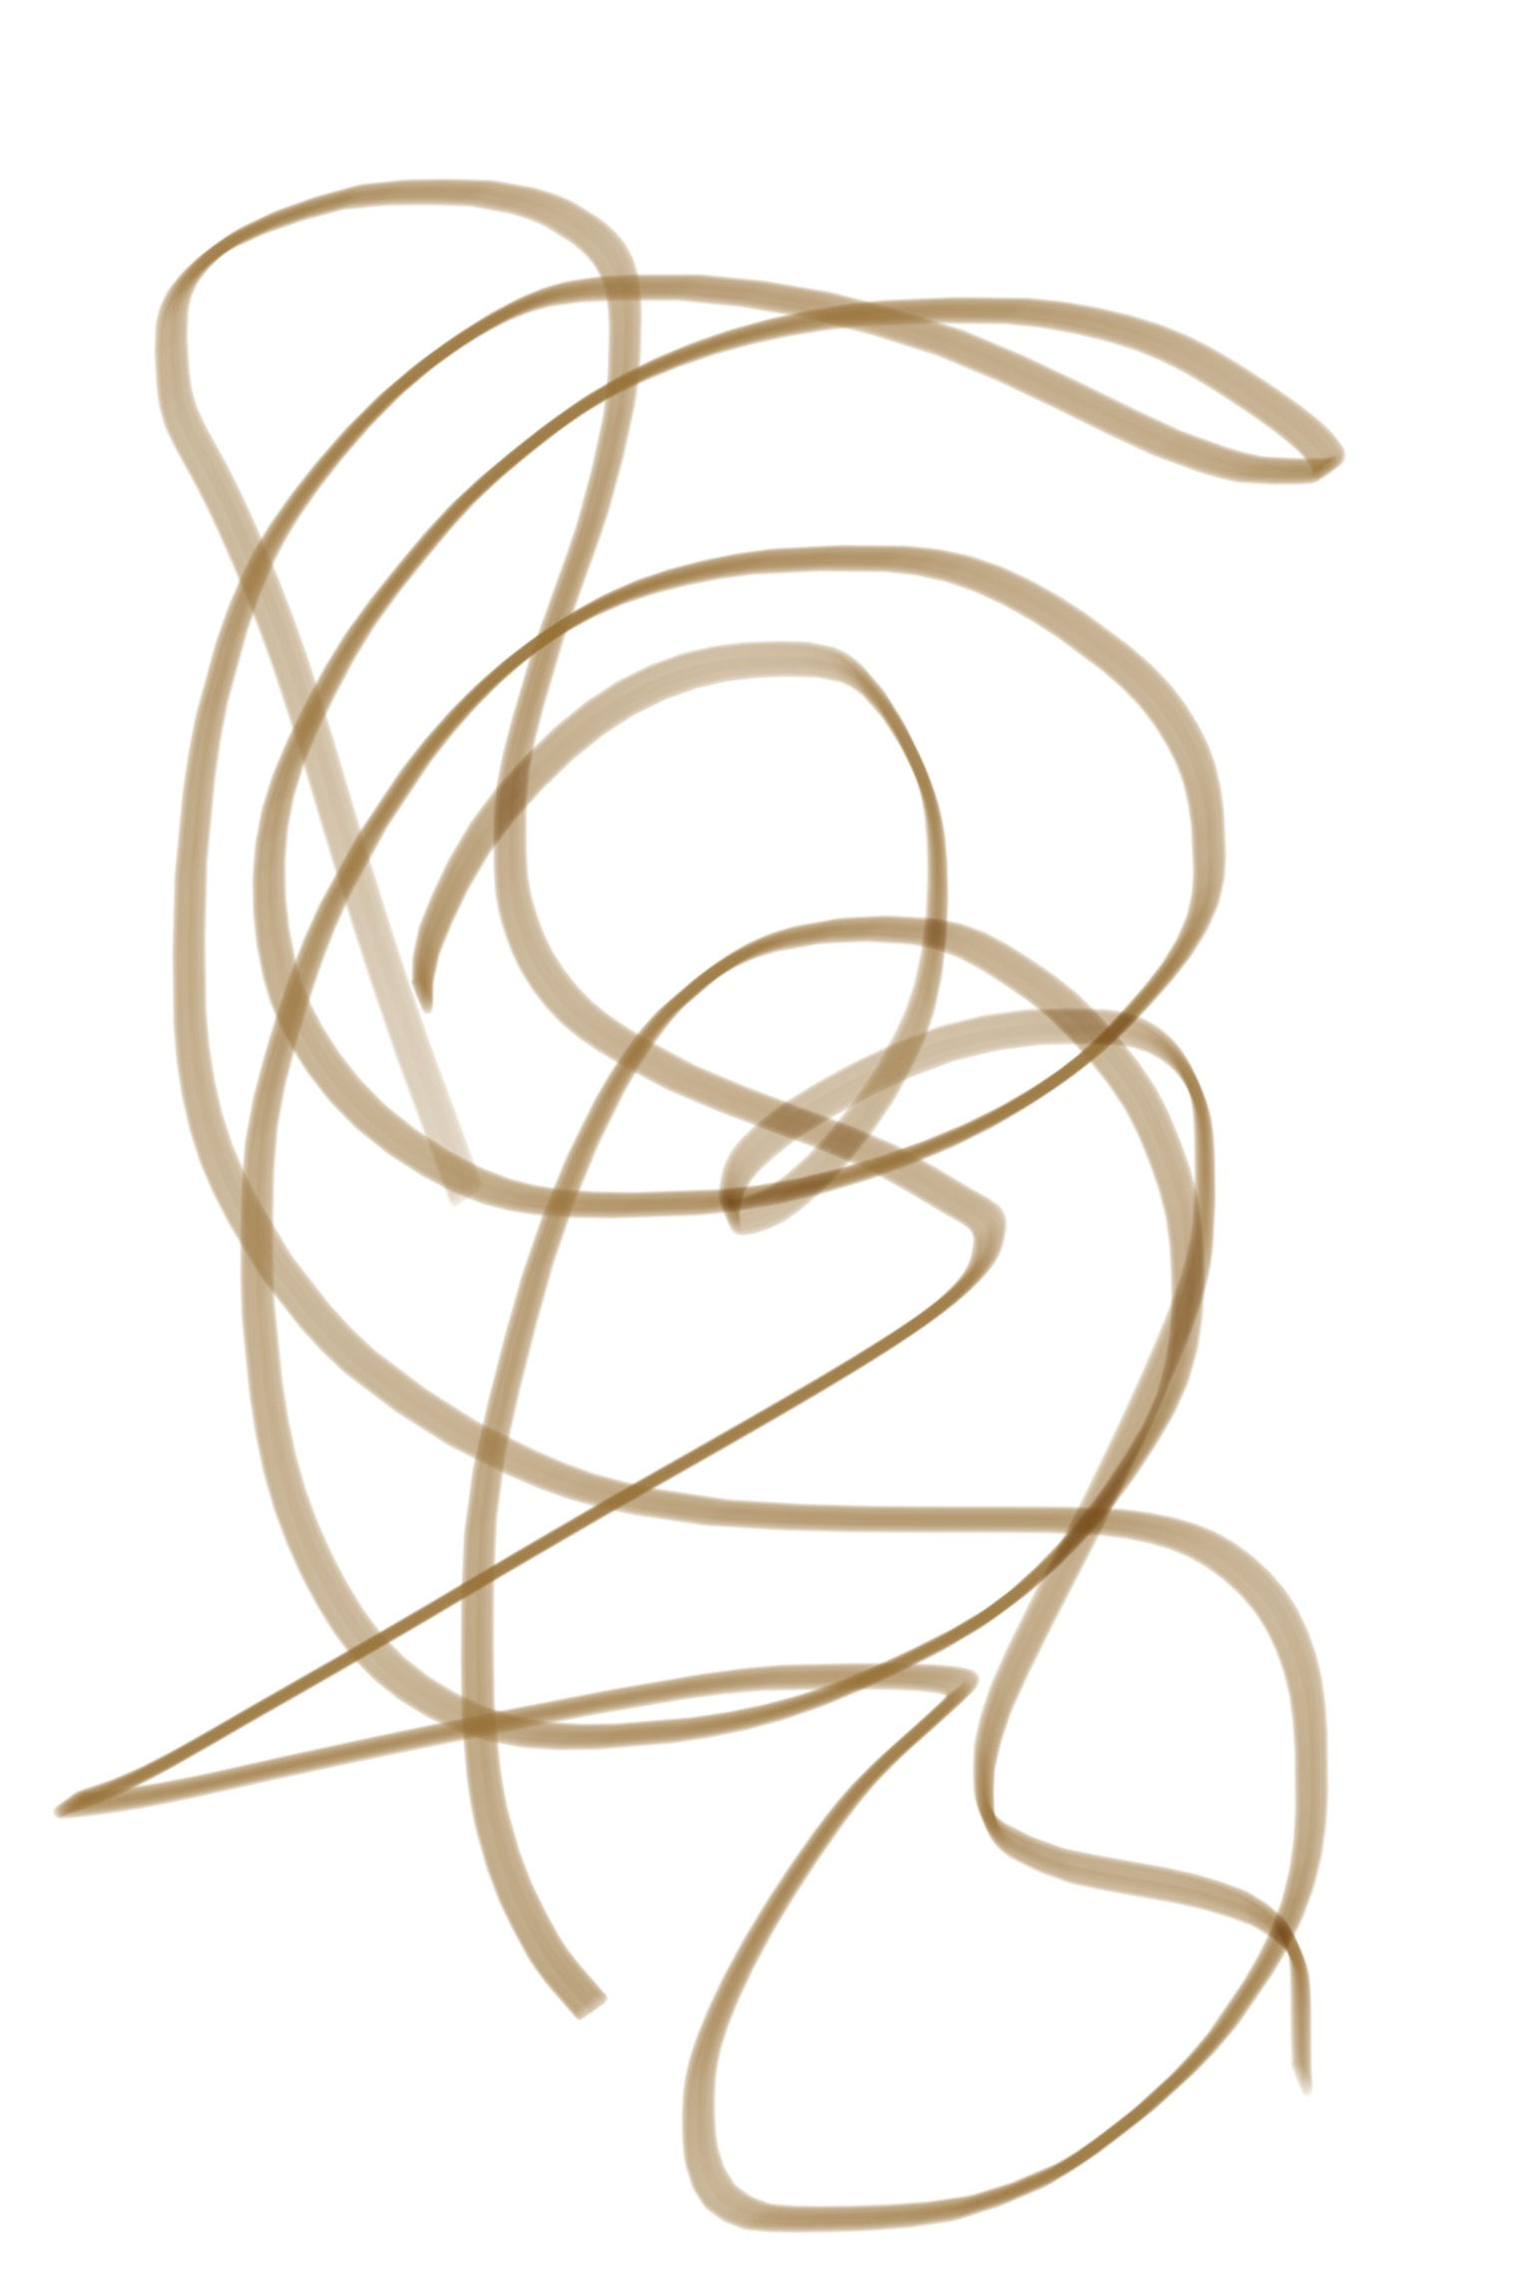
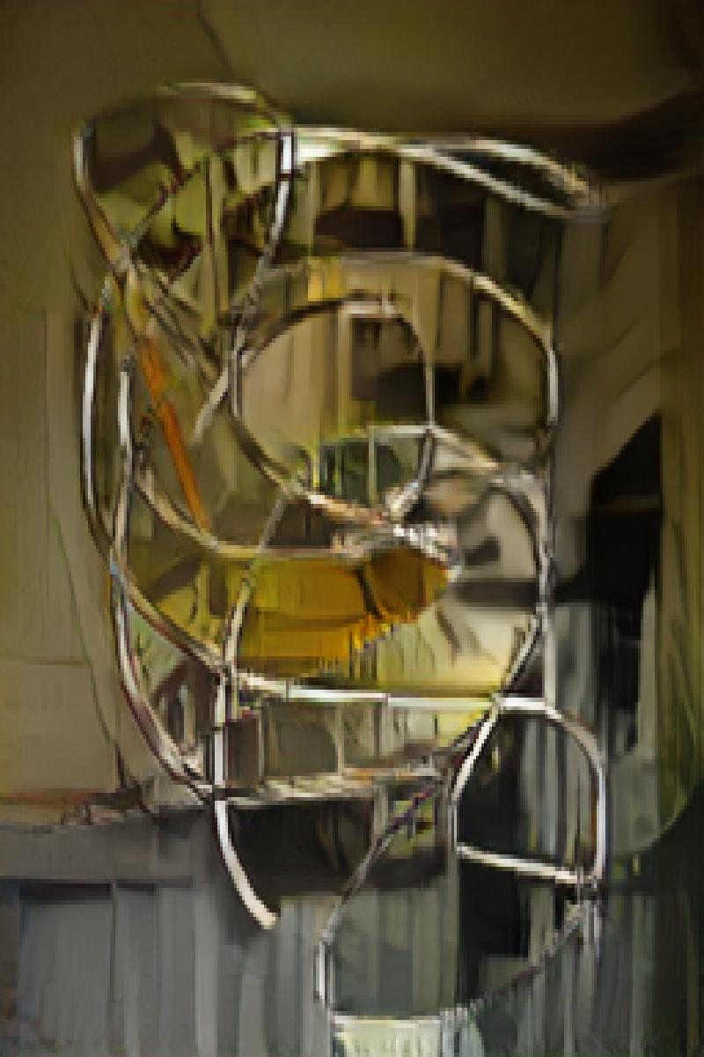
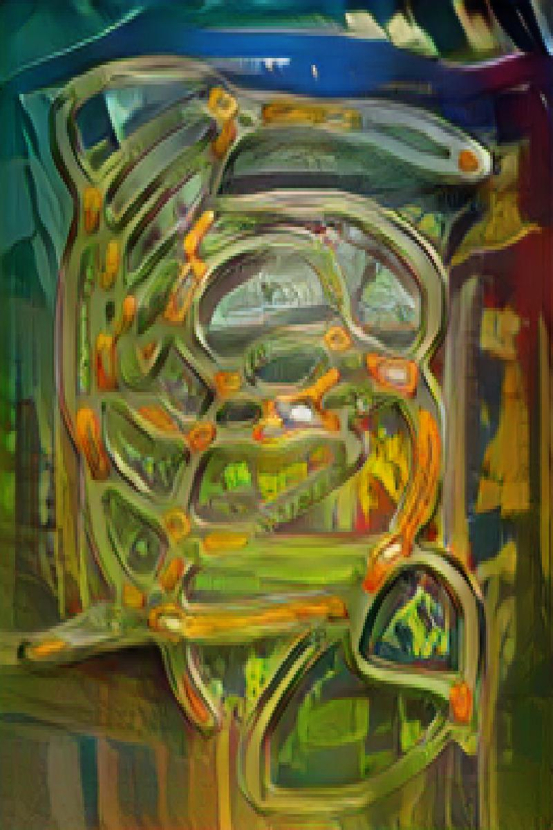
Notes:
Gaussian blur

Slide 8
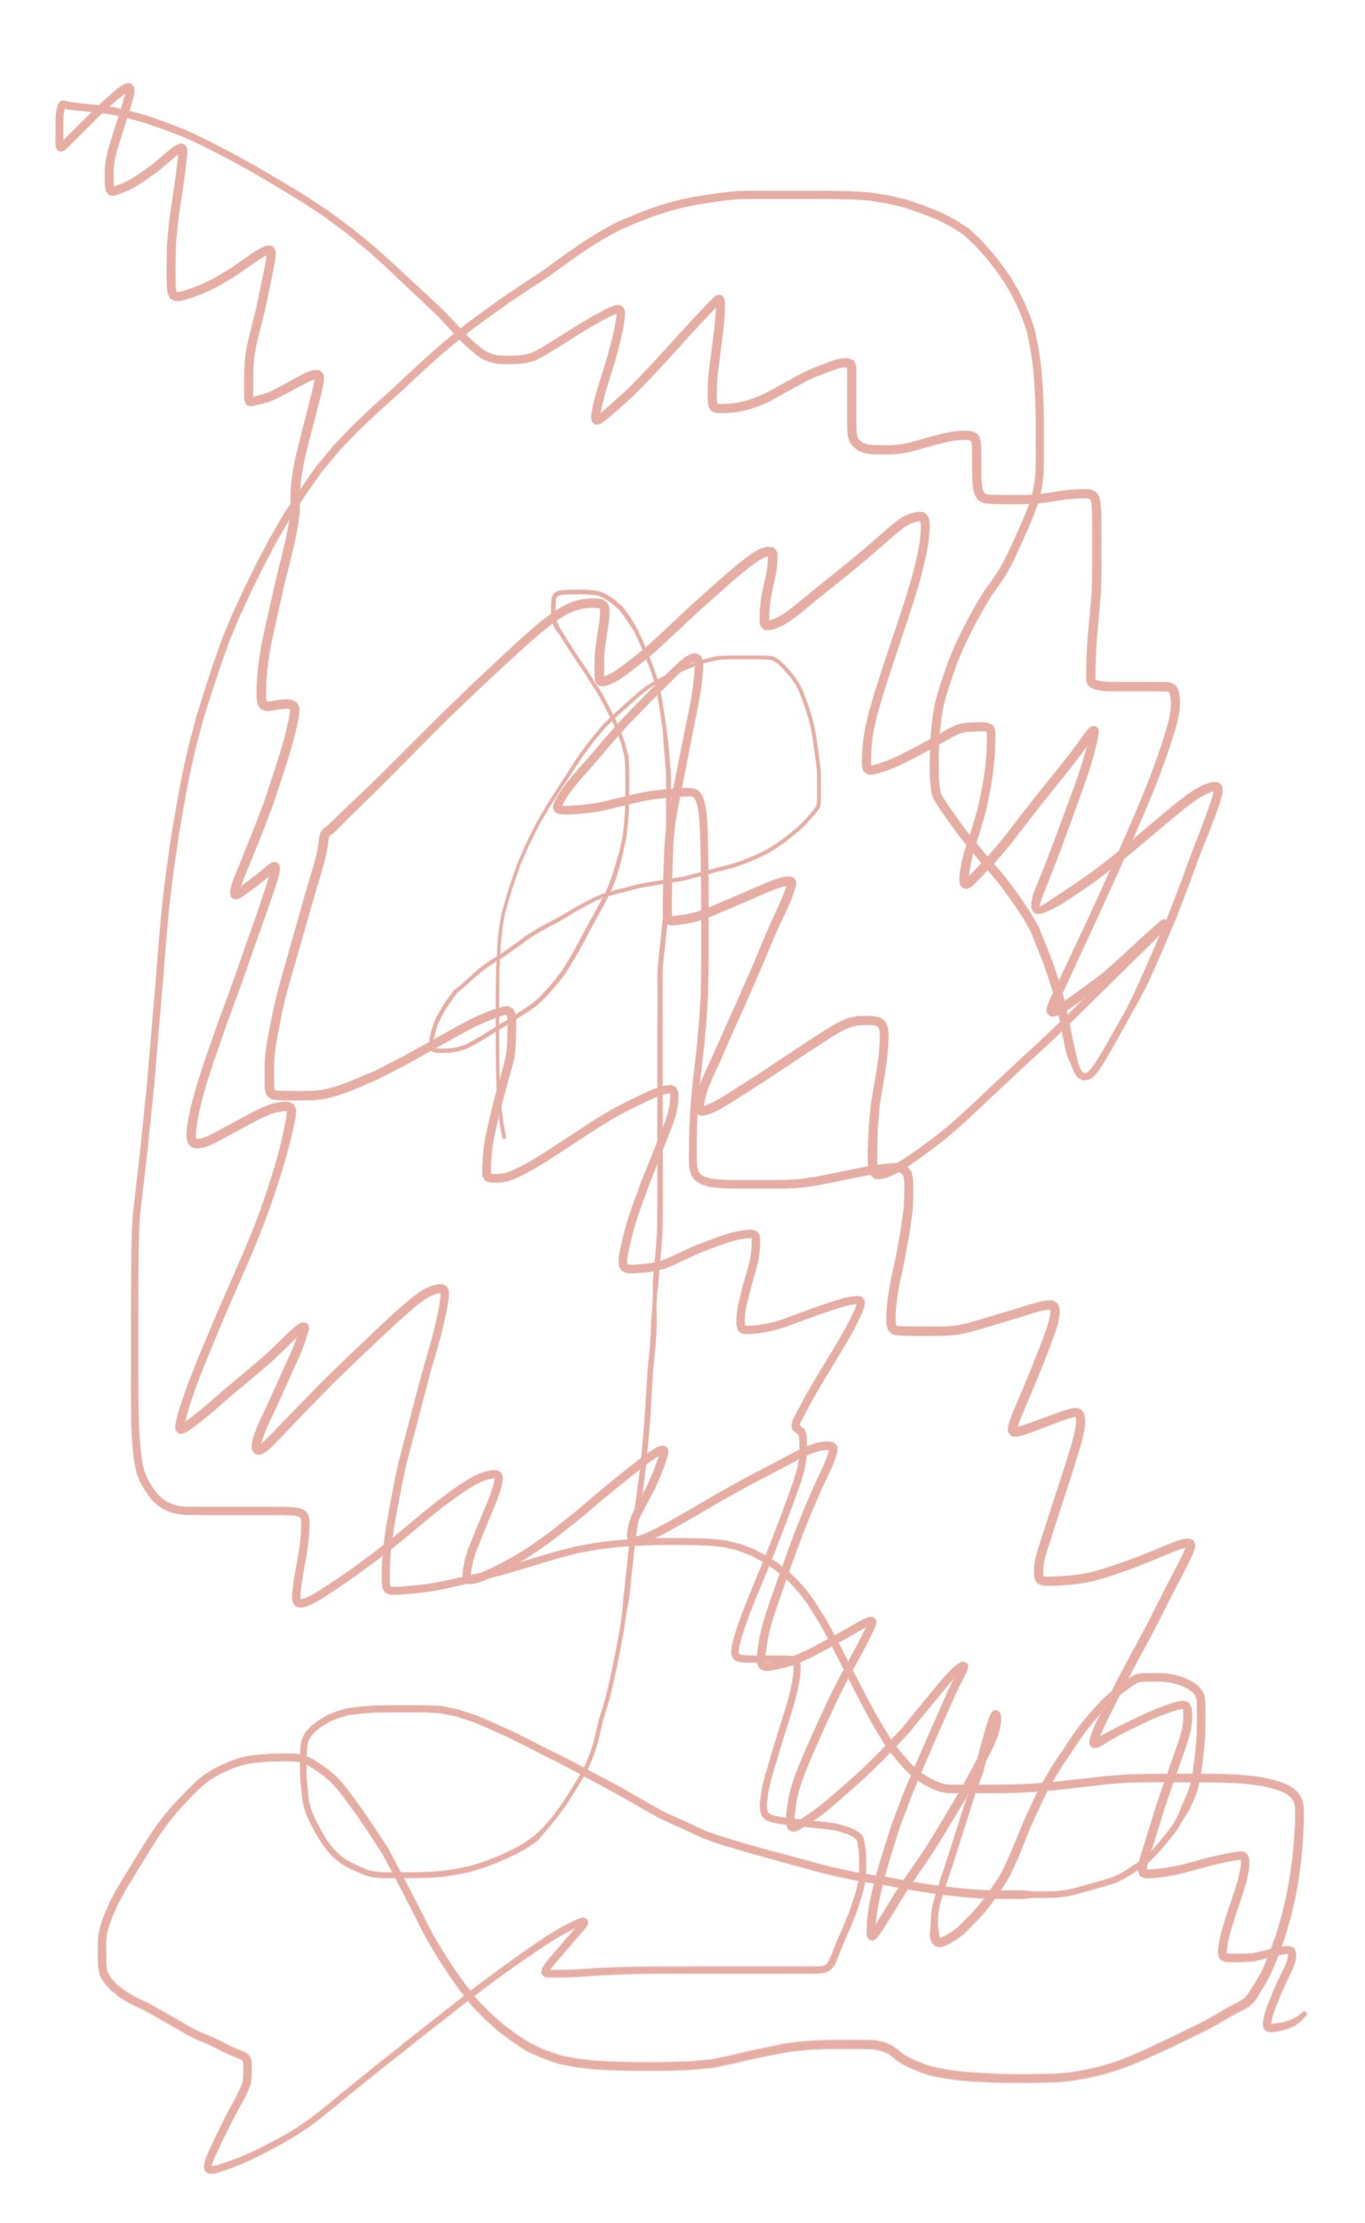
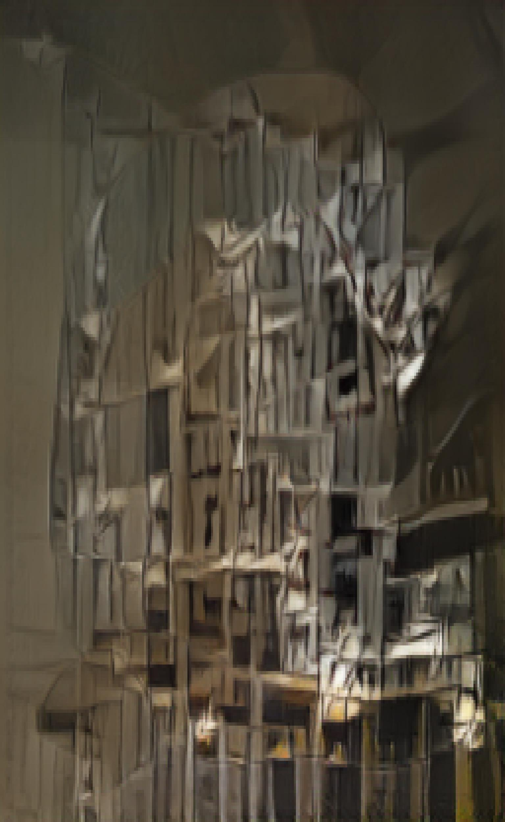
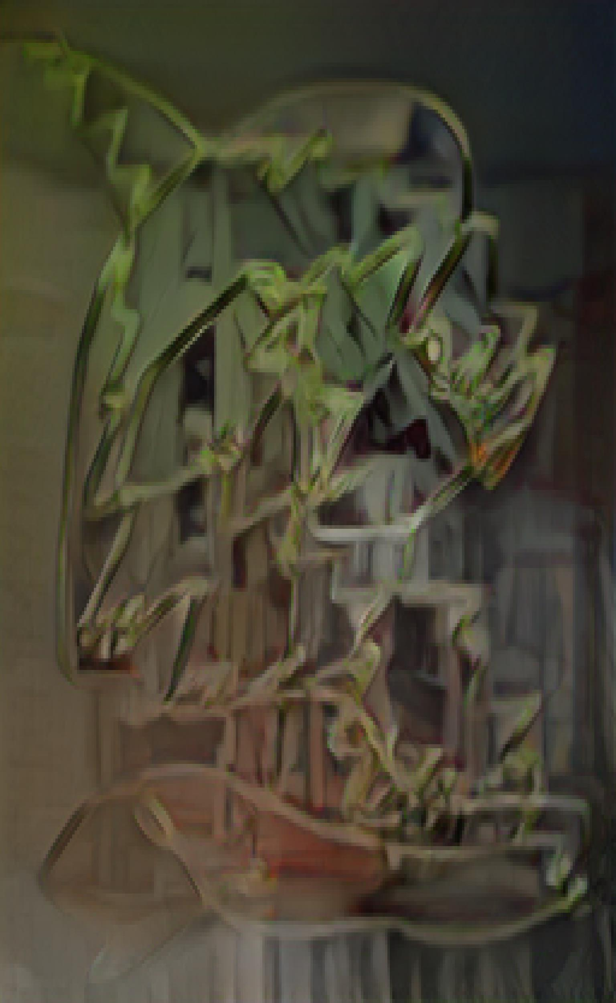
Notes:
Gaussian blur

Slide 9
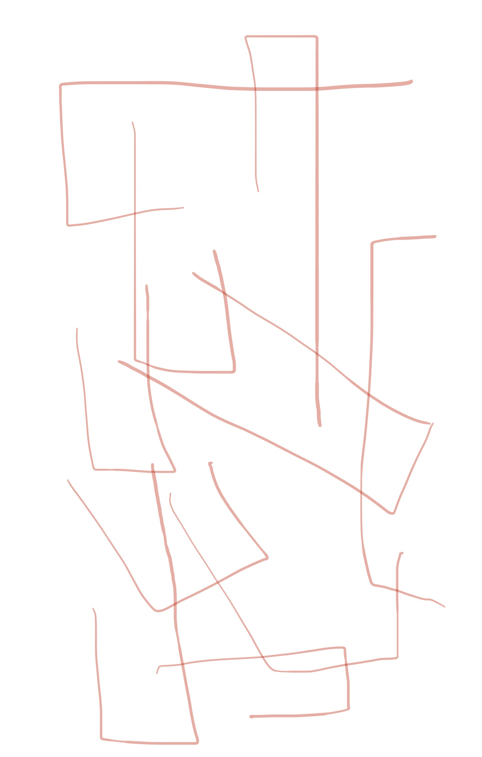
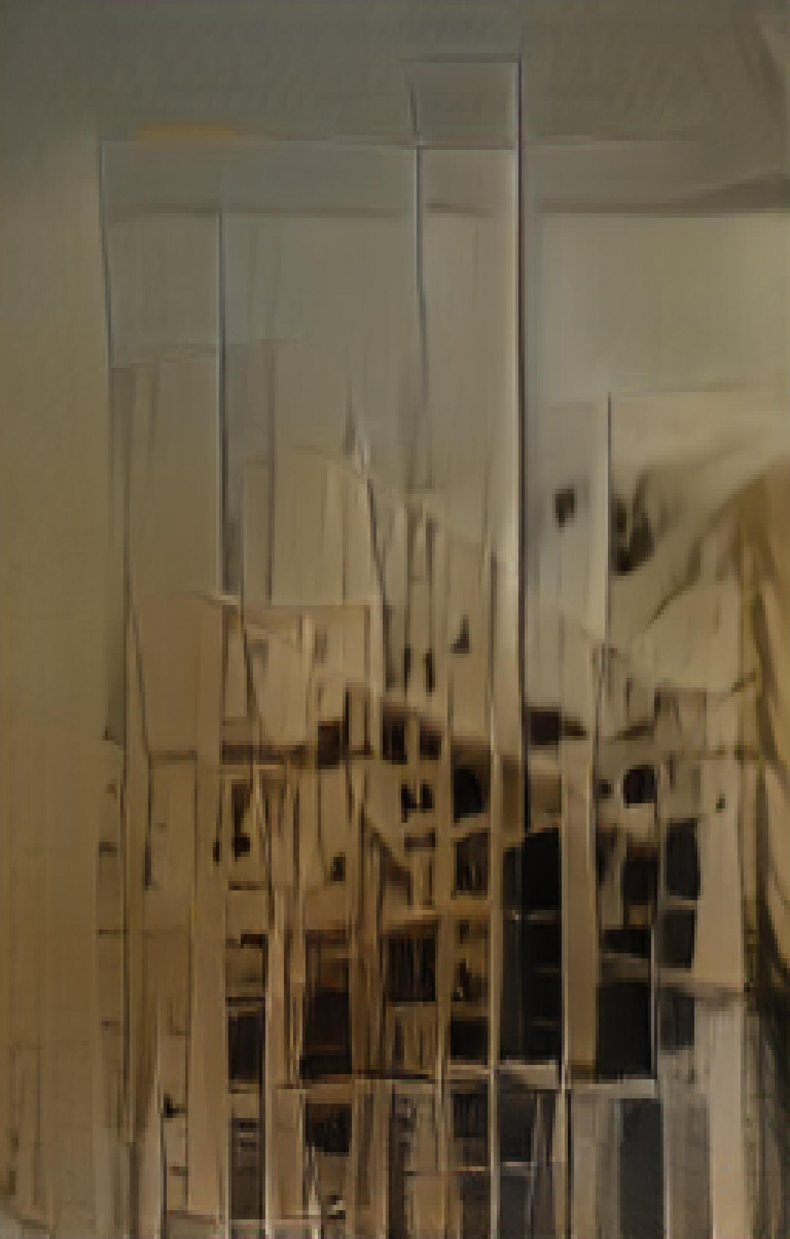
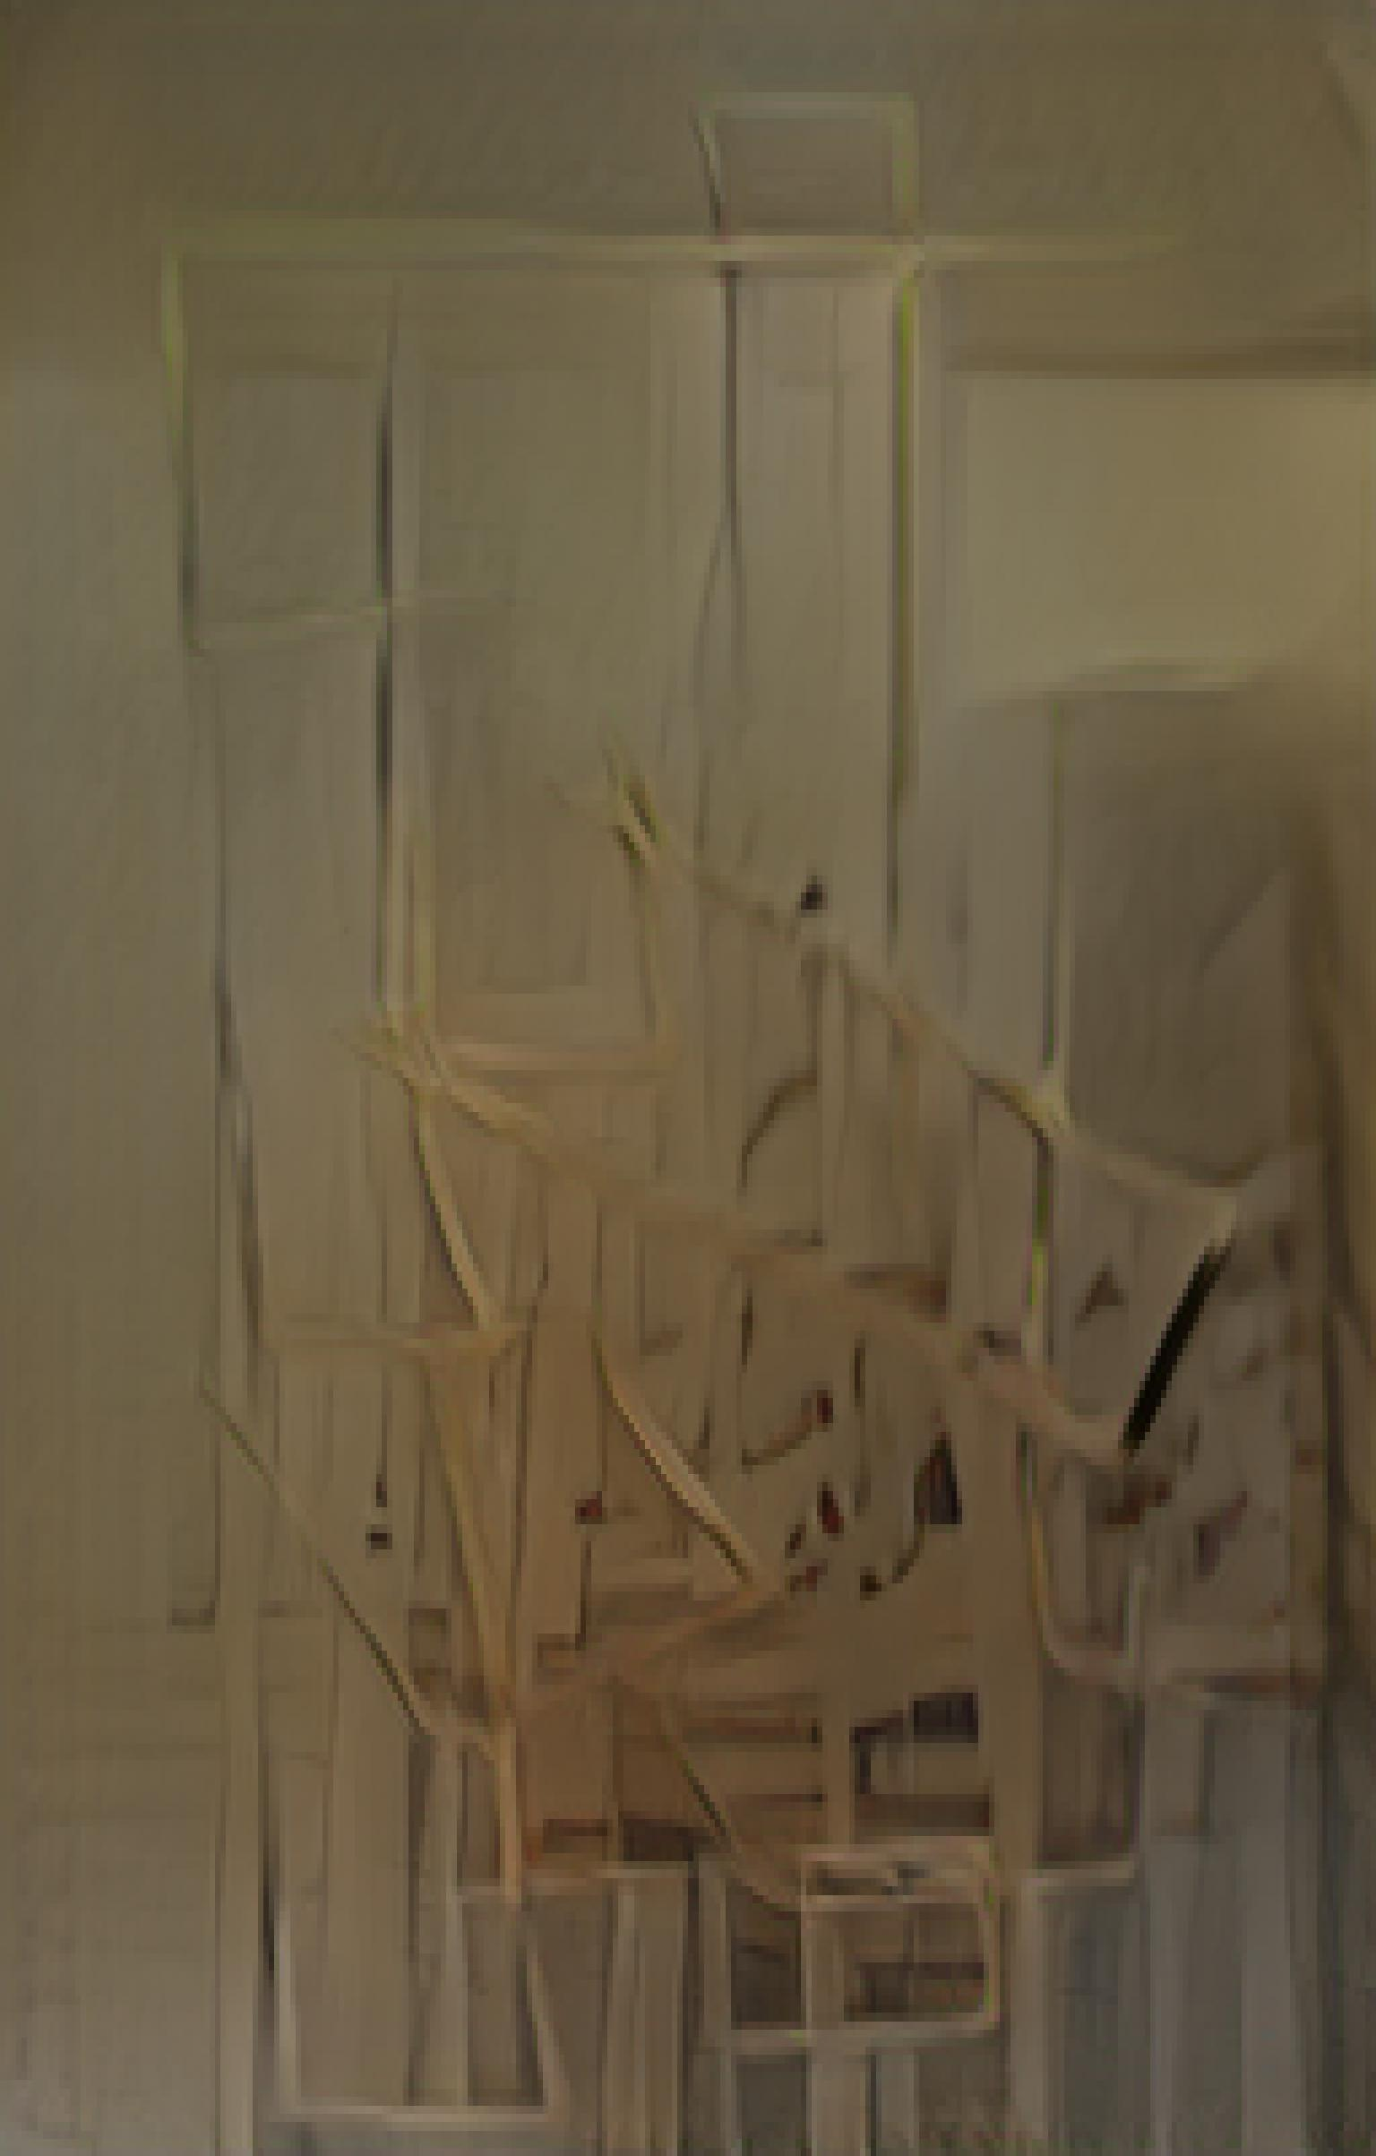
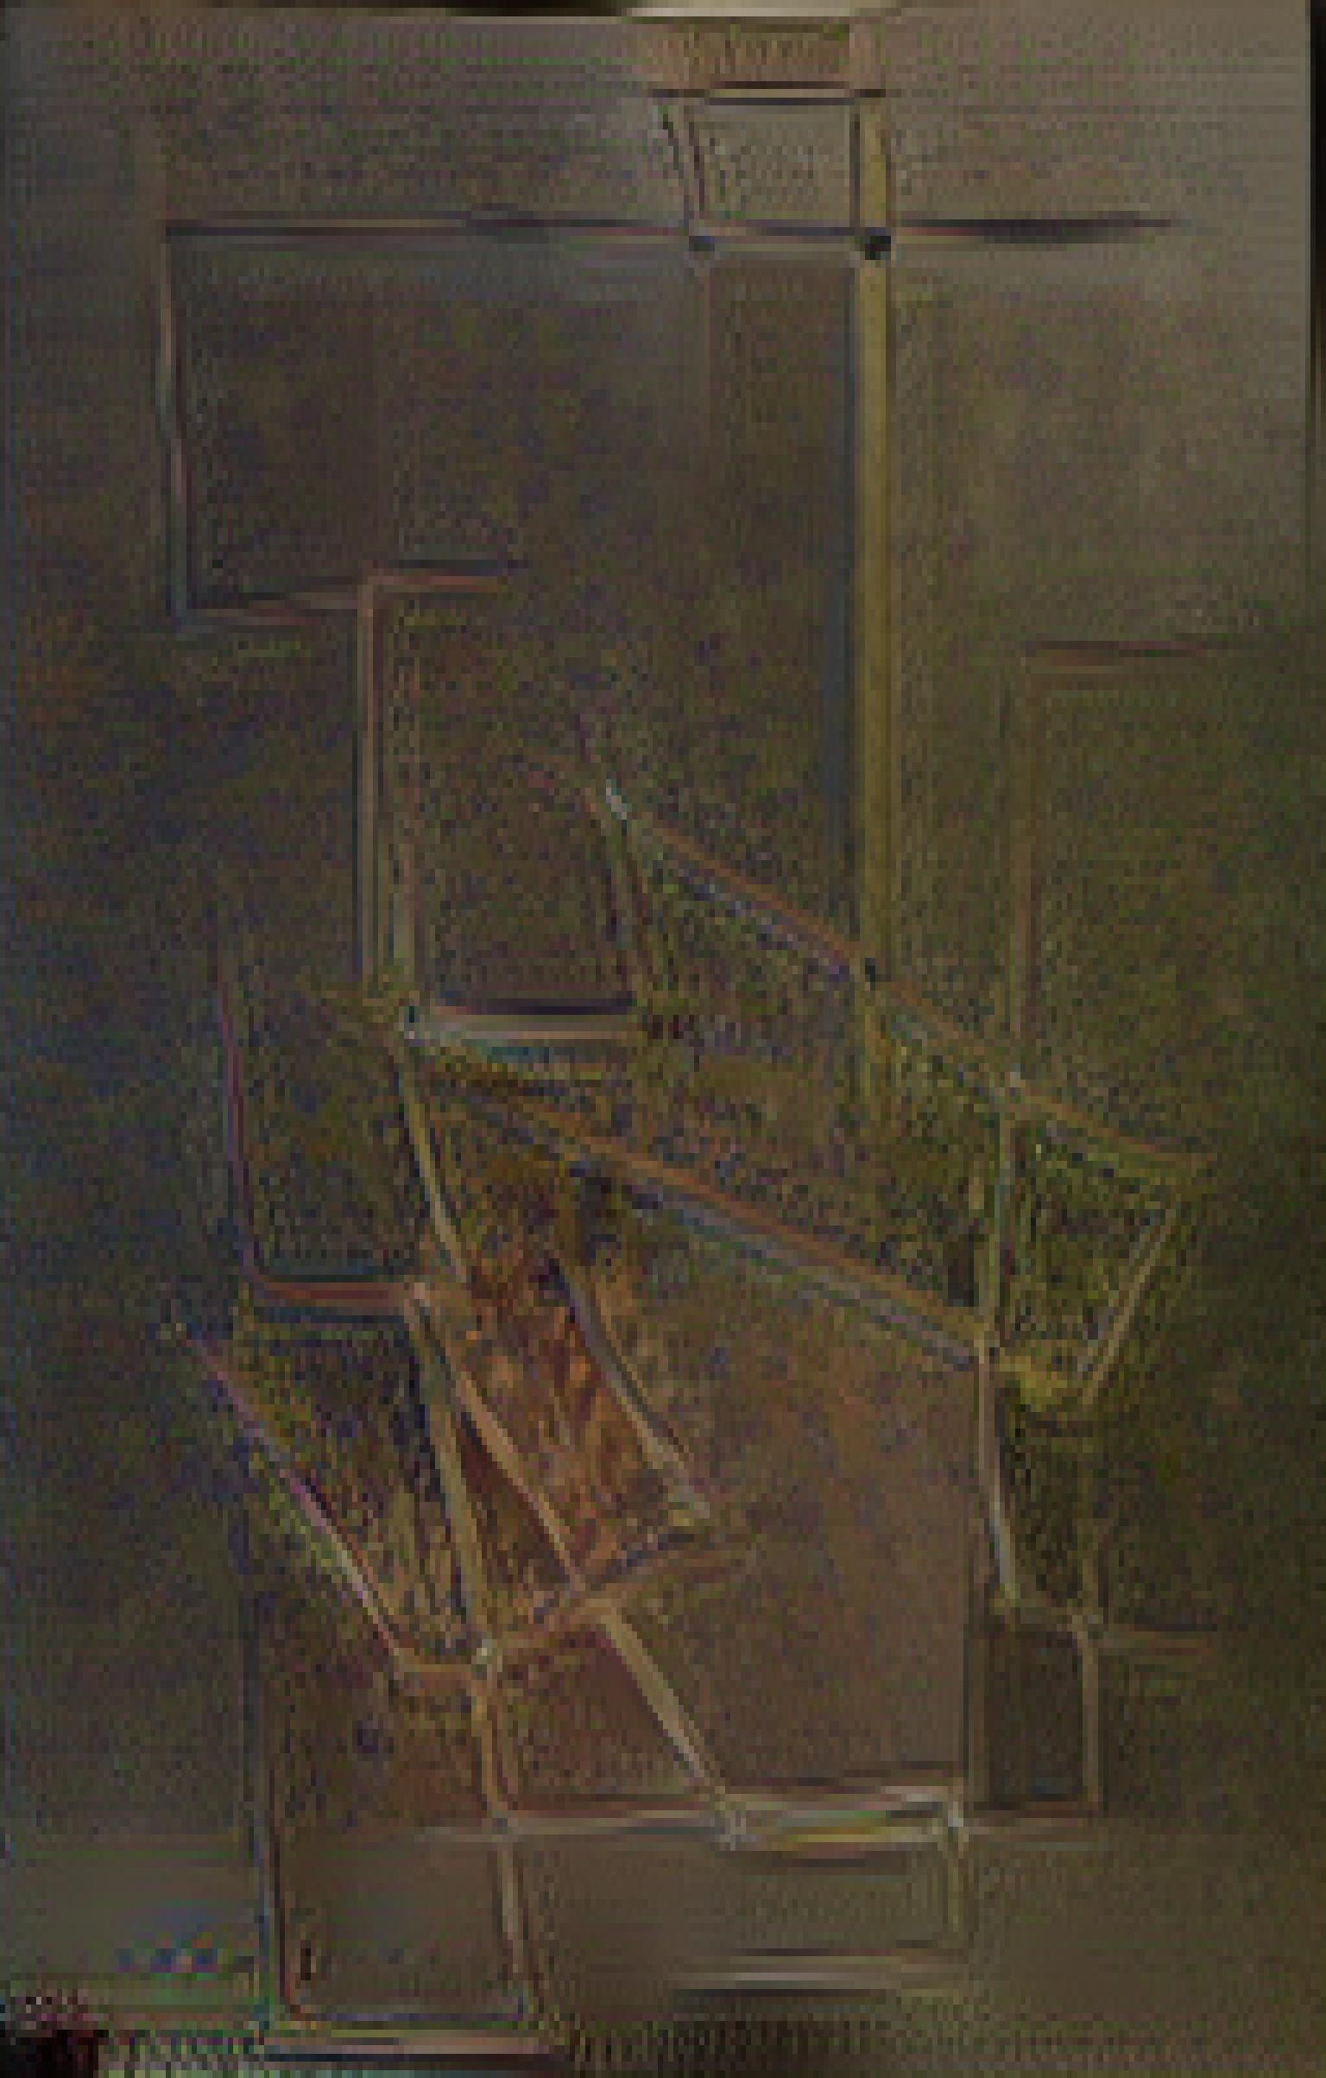
Notes:
Gaussian blur, input

Slide 10
Plotter inputs

Slide 11
Digitally coded inputs

Slide 12
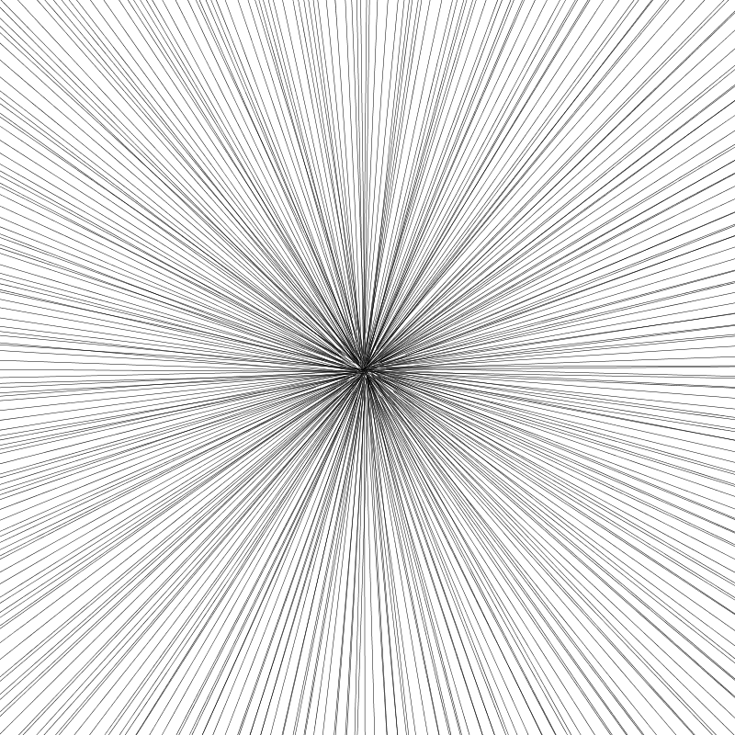
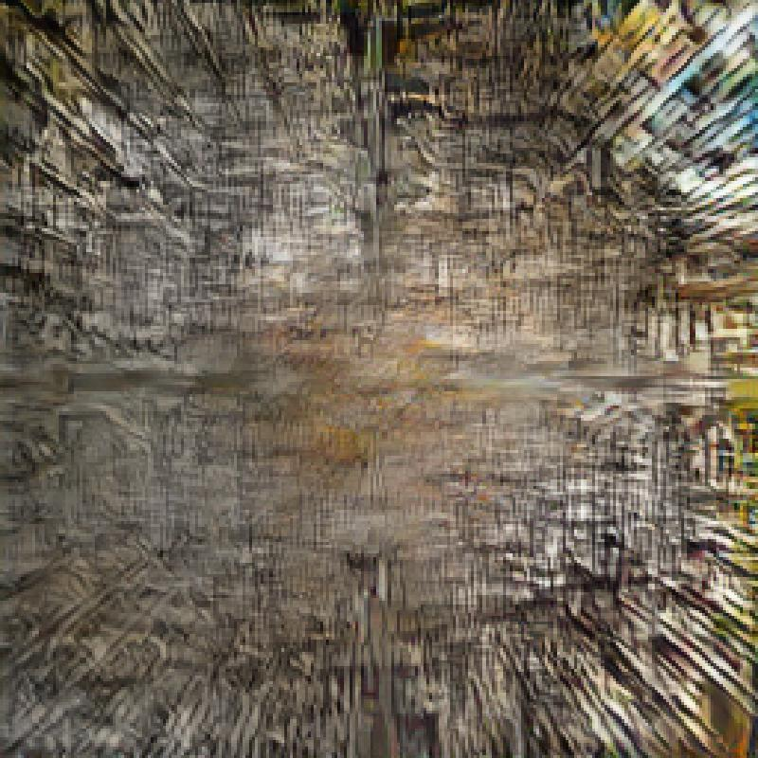
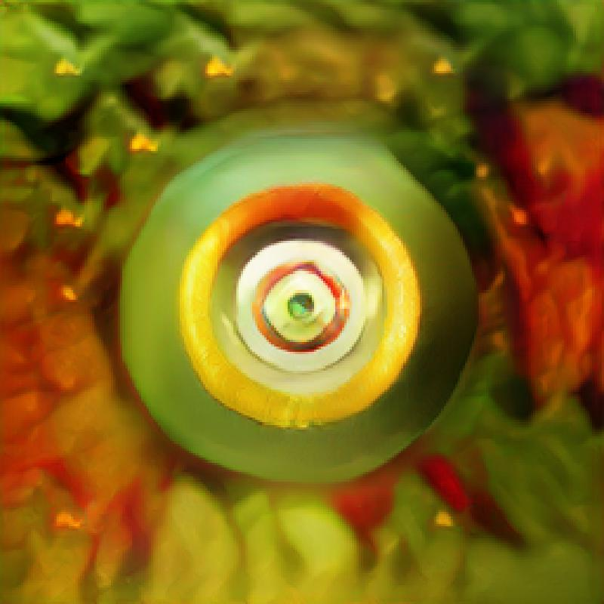

Slide 13
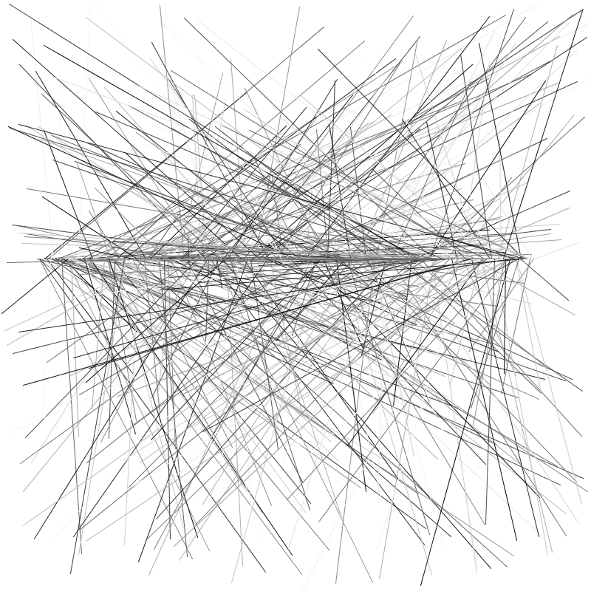
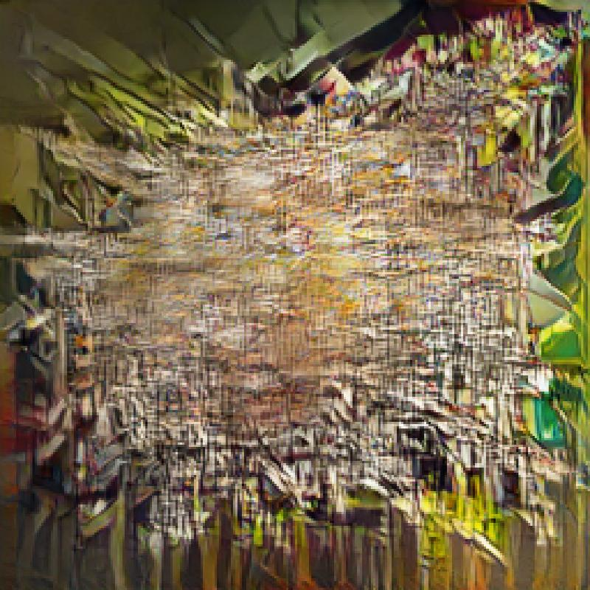
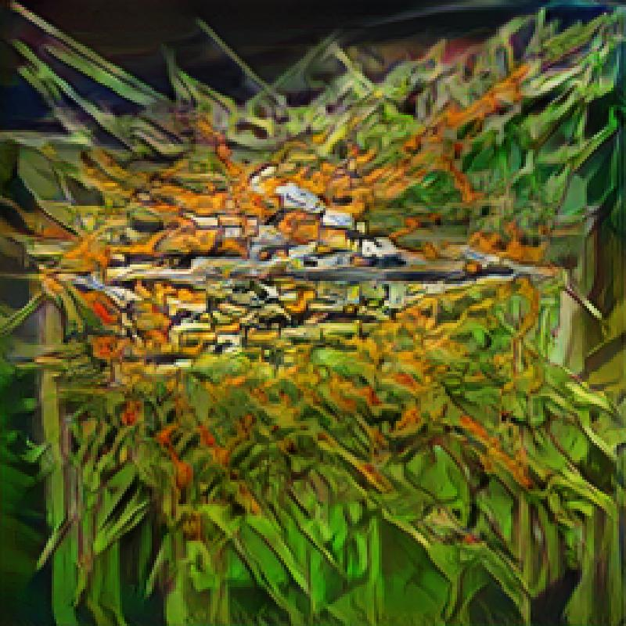
Notes:
Gaussian blur

Slide 14
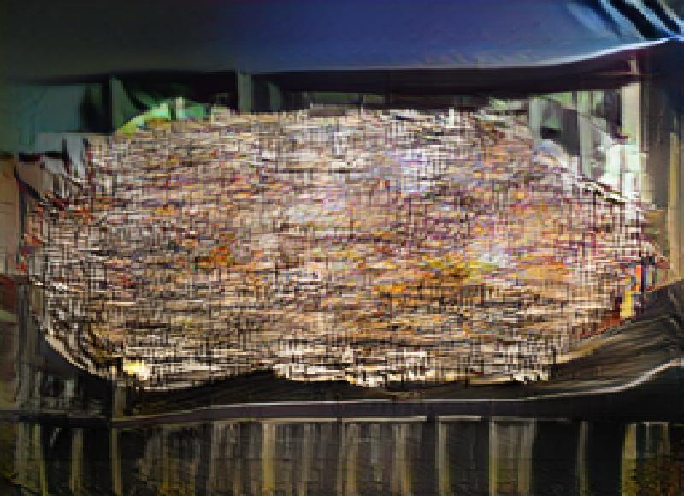
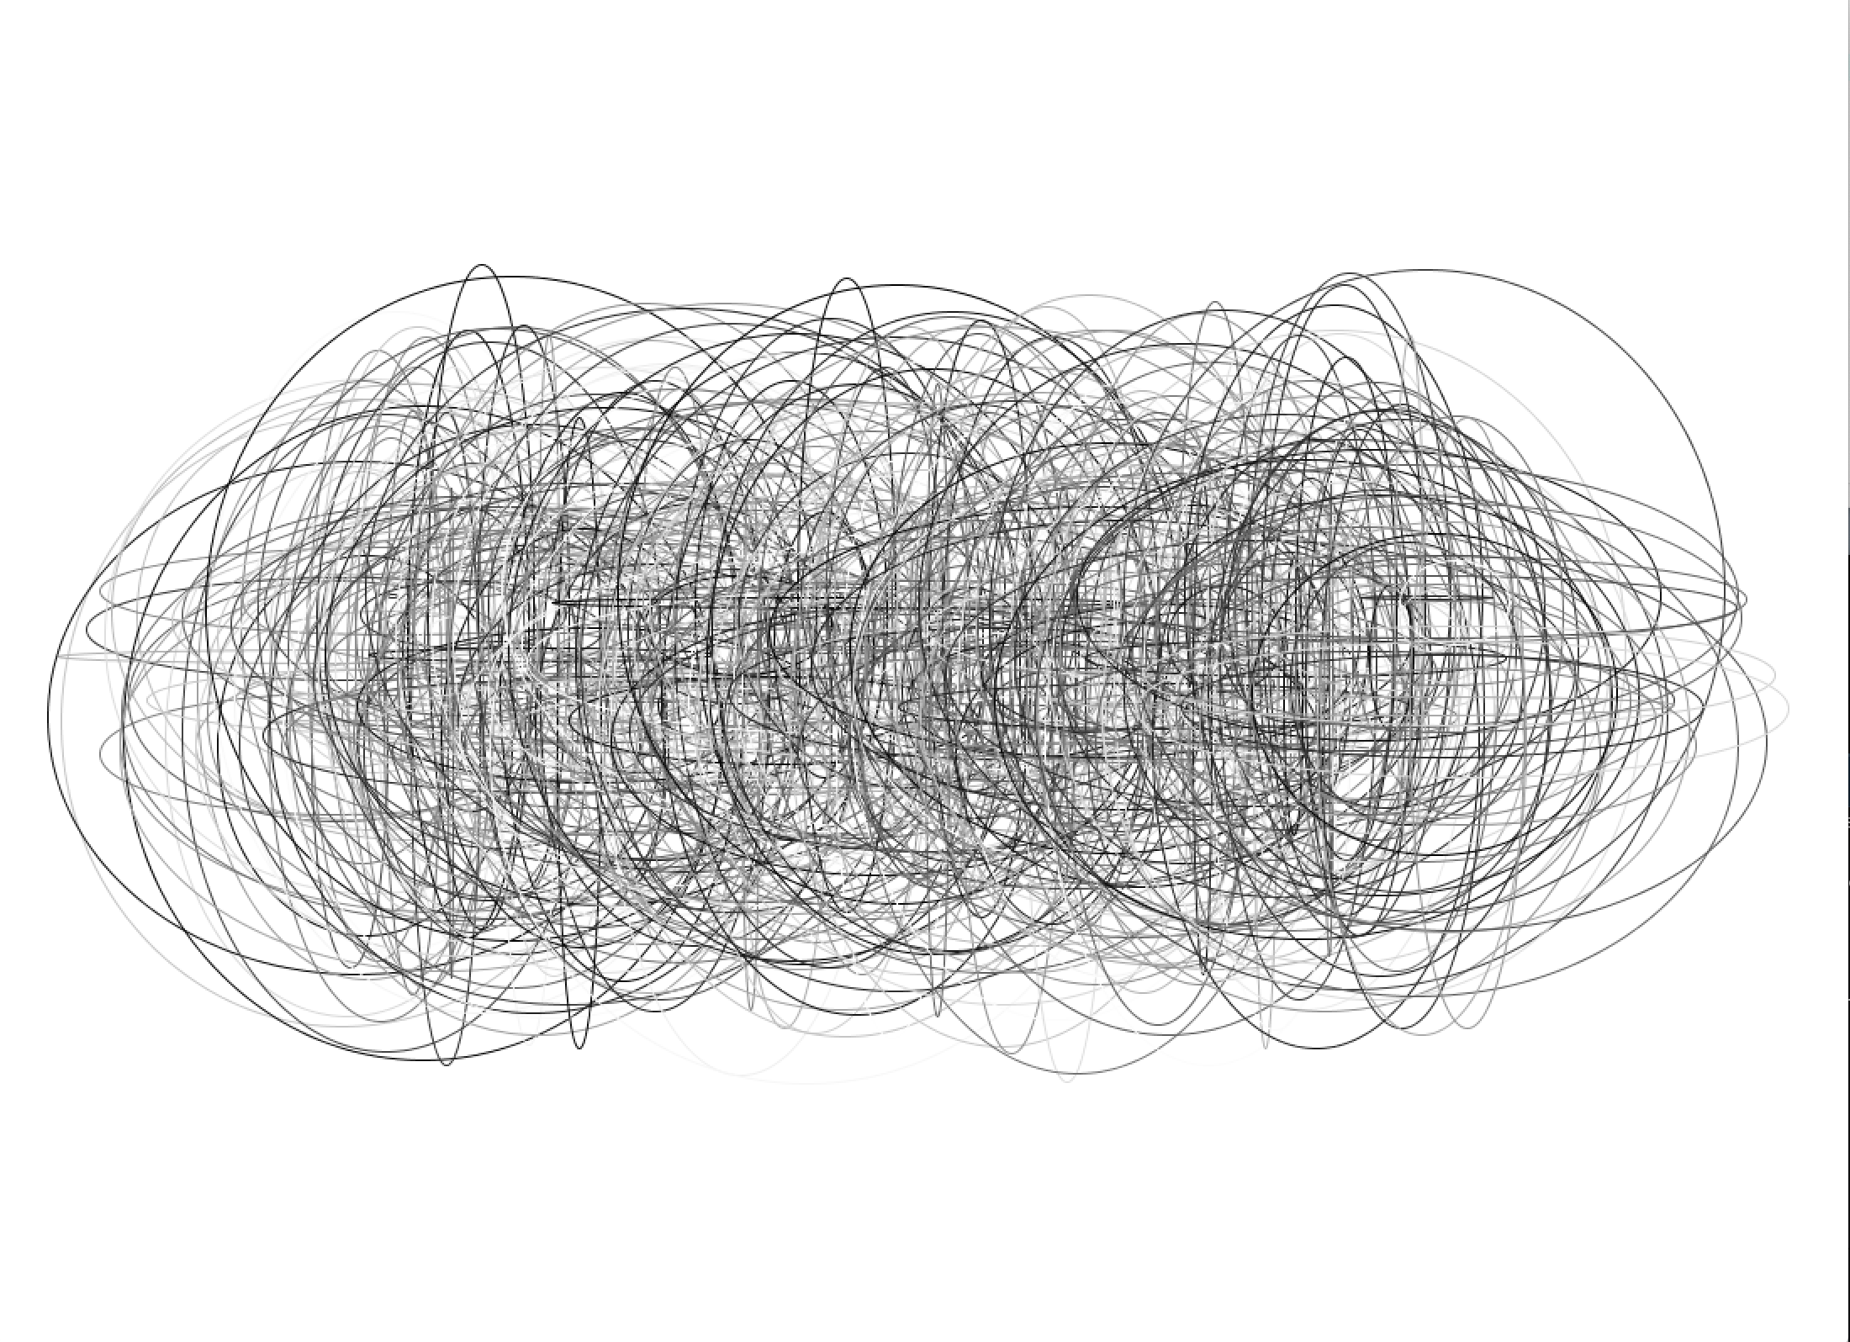
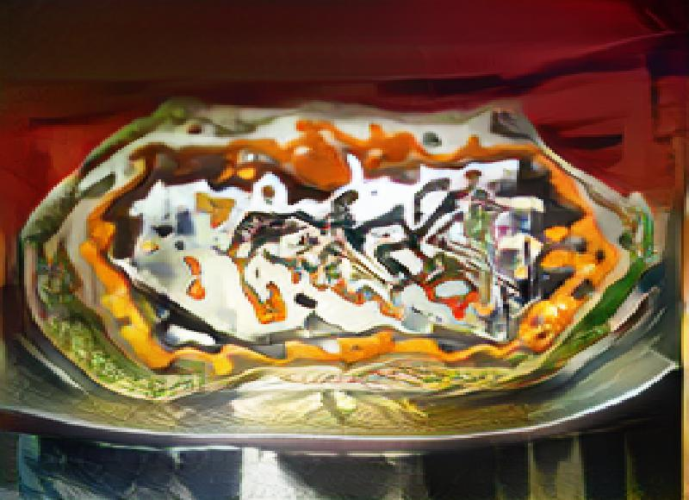

Slide 15
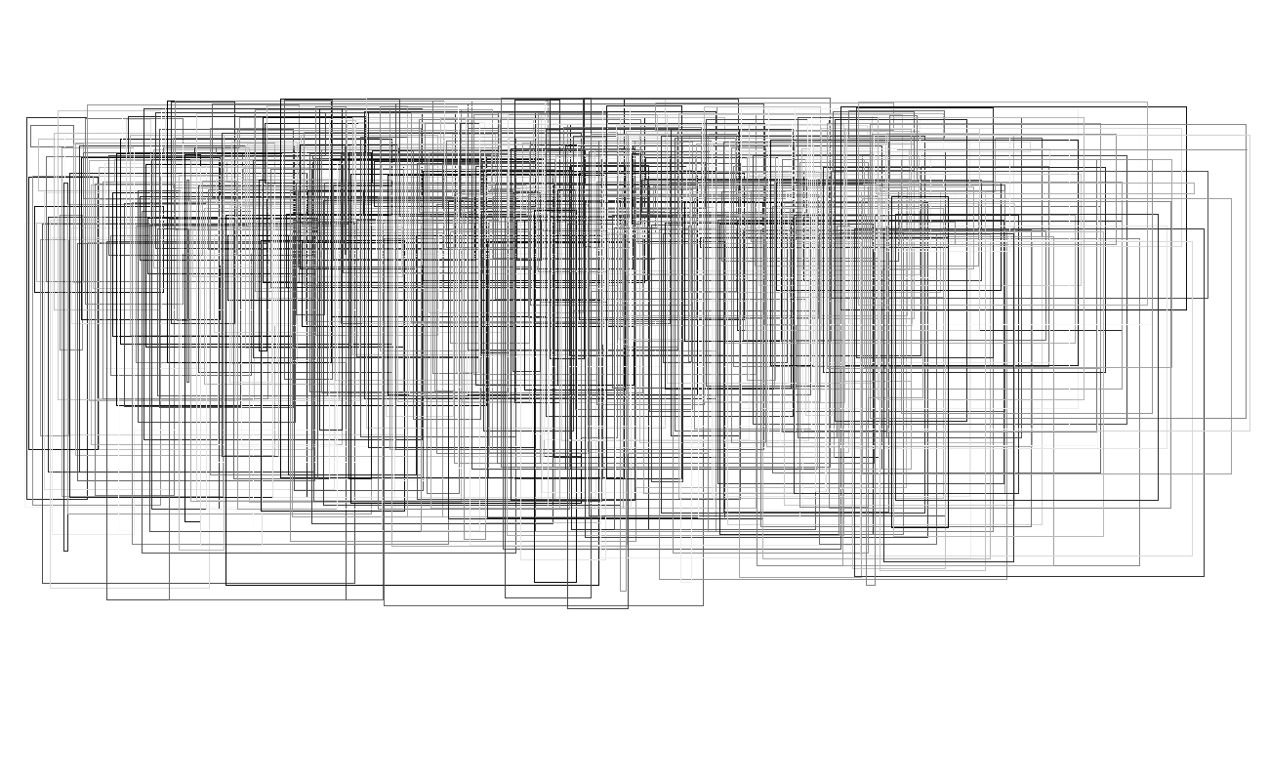
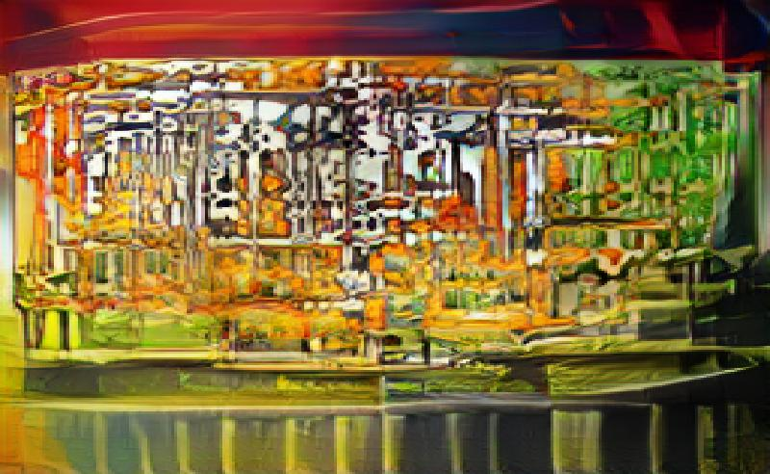
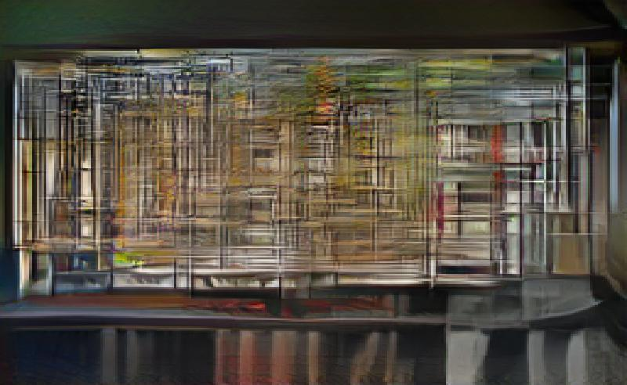
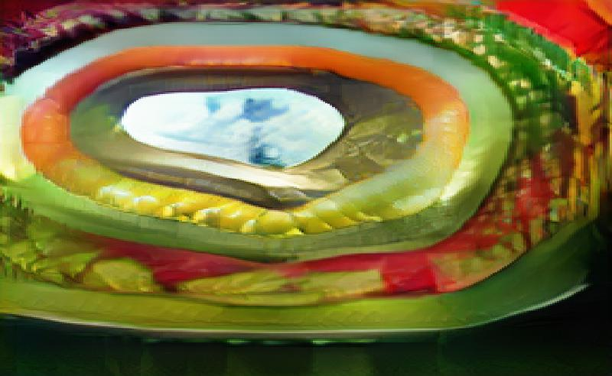
Notes:
Gaussian blur to extra gaussian blur

Slide 16
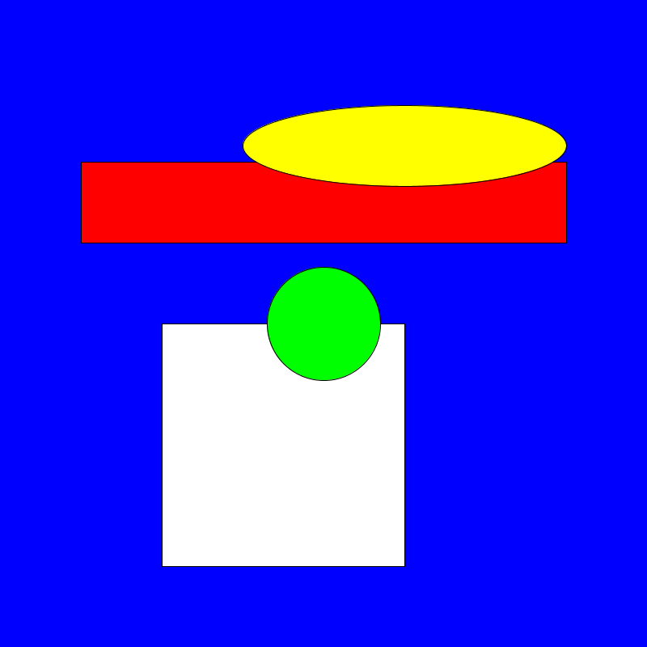
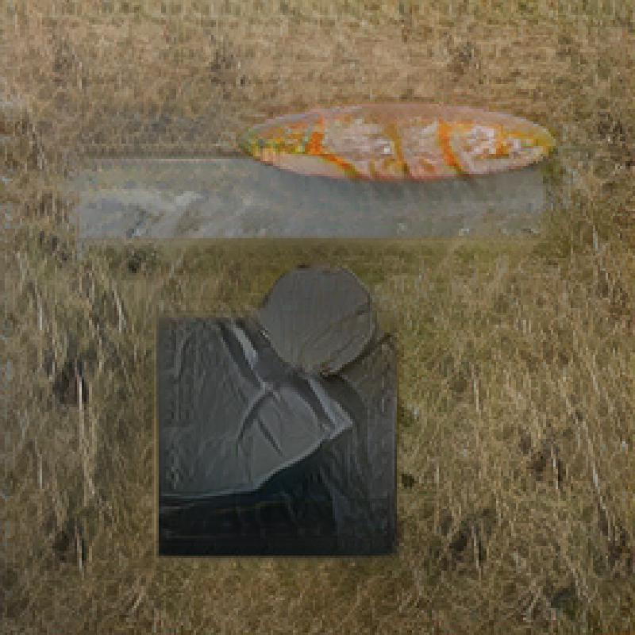
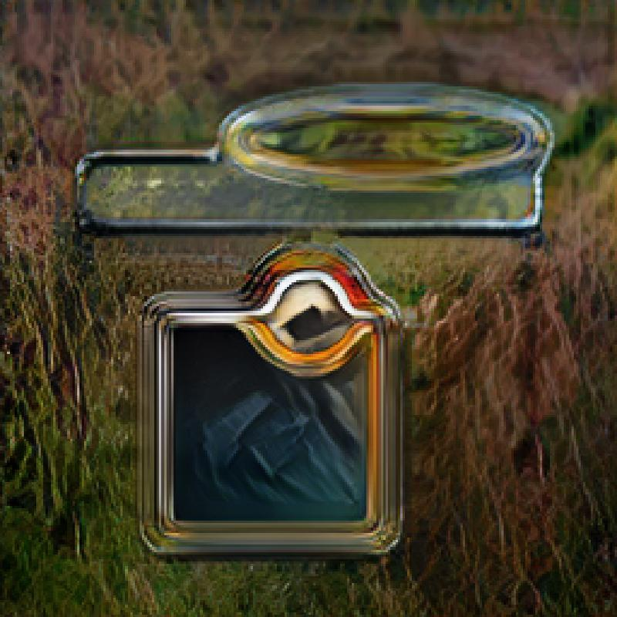
Notes:
Gaussian blur

Slide 17
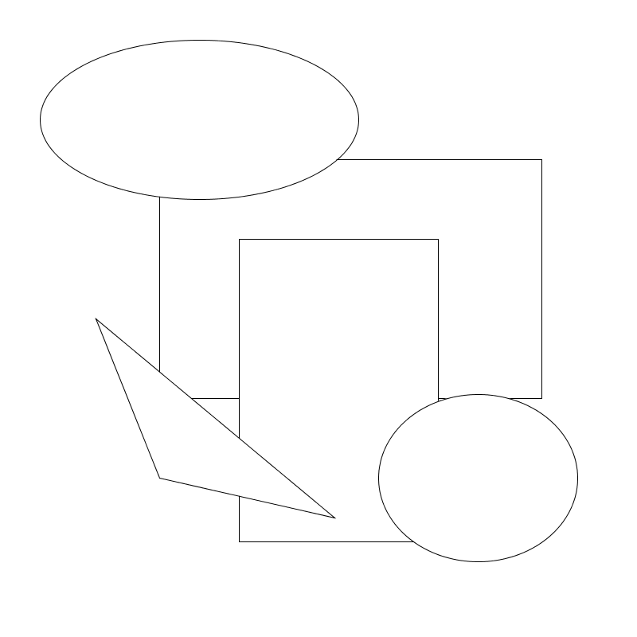
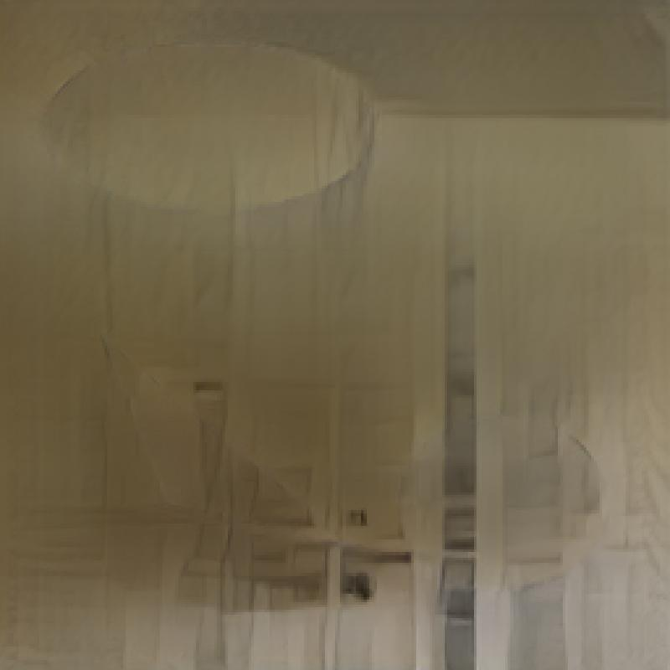
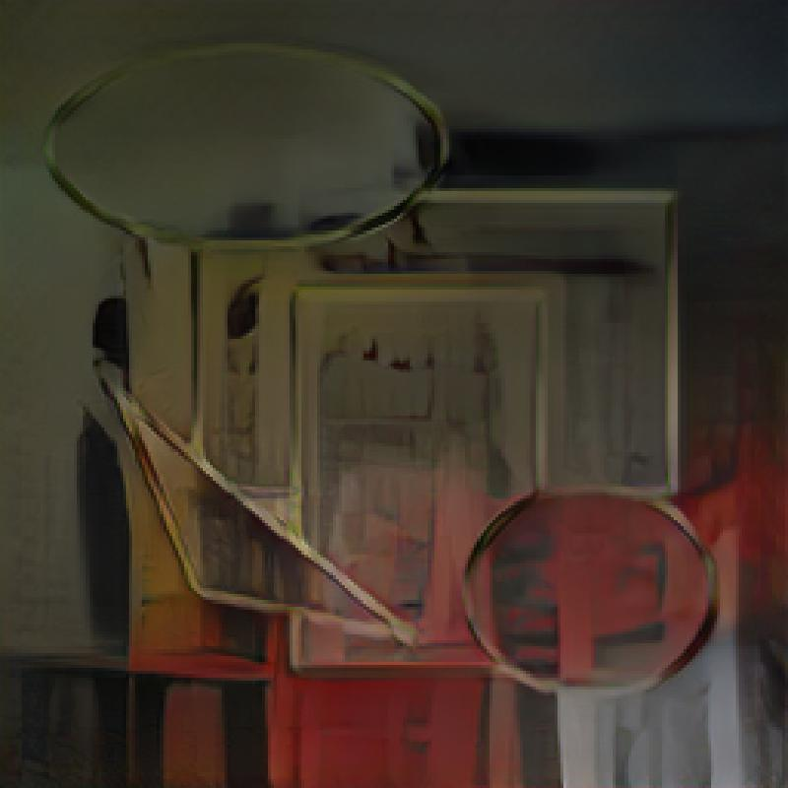
Notes:
Gauss Blur

Slide 18
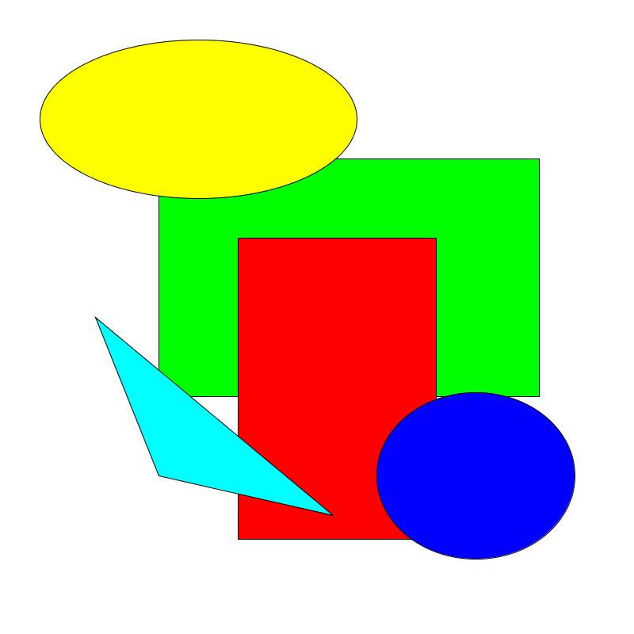
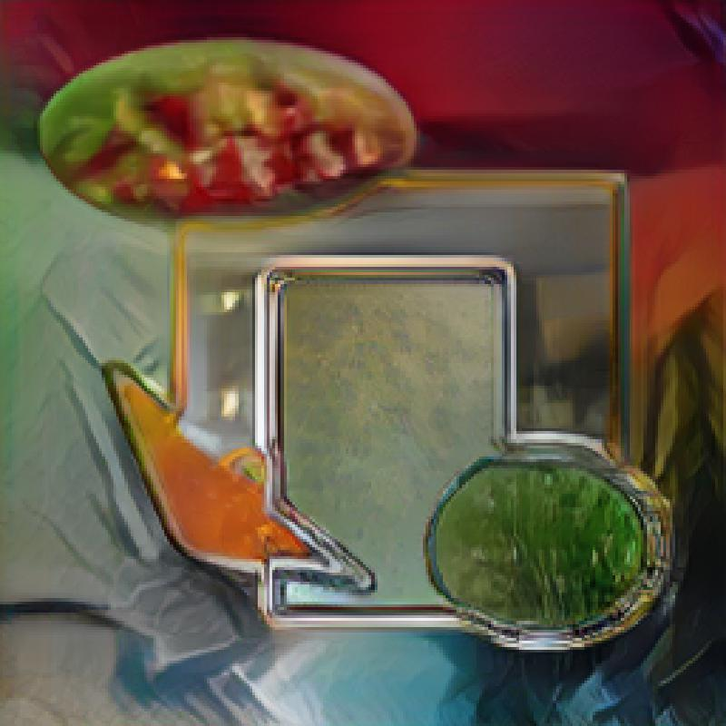
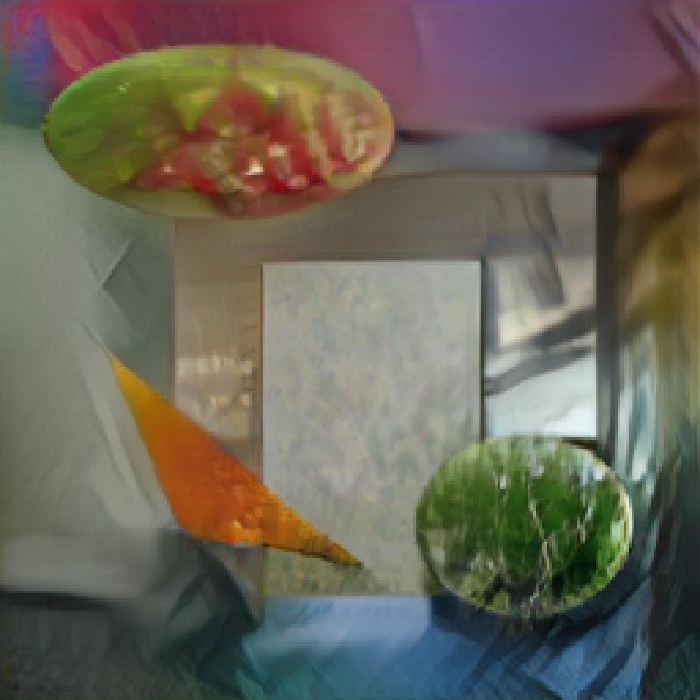
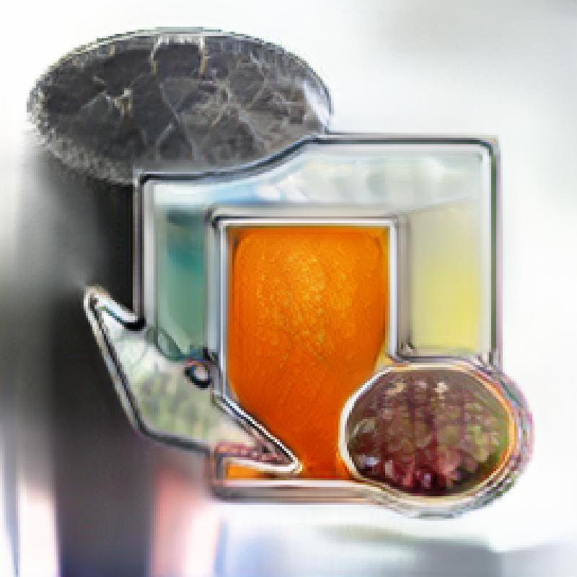
Notes:
Gauss Blur, Invert

Slide 19
Conclusions/Learning Moments!
SPADE-COCO is made for abstract shapes, but!
Can still feed abstract shape input that makes the results “non-sensical” for what it was built for (instead, more of an aesthetic/design output)
Line-work (esp. mark-making) confuses the system (which makes sense, the GAN probably works with shape detection)
Gaussian blur:
Sometimes brings out input drawing more in output
Yields some very interesting results

